Slide 1
Kenya Medical training college
Faculty of Clinical Sciences
Department Of Orthopaedics and Trauma Medicine
General Orthopaedics I
By
Gideon Sifirino
Class: March 2022
15th ,March 2024

Slide 2
Introduction to Orthopaedics
Orthopaedics has come a long way since
the days of Nicholas Andry, a
French physician, who is credited for
coining the term, orthopaedics from two
words, Ortho: straight and Paedics: child.
(Ebnezer, 2012)

Slide 3
Early Pioneers and Founding Fathers
The ancient Greeks were prone to
injuries resulting from an agrarian society
and athletic pursuits.
(Sivananthan, Sherry, Warnke, Miller 2012)

Slide 4
Cont’d
Hippocrates (c. 460–370 BC ), born on the Greek
island of Cos, routinely faced
the problem of shoulder dislocation in
his burgeoning medical practice.
(Sivananthan, Sherry, Warnke, Miller 2012)

Slide 5
Cont’d
Among his many advances in establishing medicine as a discipline, Hippocrates dealt with acute dislocation, faced the problems of
delayed reduction and saw cases of
pathological dislocations attributable to supperative conditions such as tuberculosis.

Slide 6
Cont’d
Nicholas Andry (1658–1742), was the first figure after Hippocrates to signal a change
in orthopaedic medicine.
Thus began orthopaedic medicine, and with it orthopaedic surgery.
(Sivananthan, Sherry, Warnke, Miller 2012)

Slide 7
Cont’d
In Andry’s time orthopaedic surgery in
the form known today did not exist.
Surgery was still primitive.
Indeed, except for sporadic attempts by ingenious individuals, it is probable that
little real progress had been made.

Slide 8
Cont’d
After Andry, more medical explorers stepped into the new specialty.
In the case of two physicians,
personal injury pointed the way.
(Sivananthan, Sherry, Warnke, Miller 2012)

Slide 9
Cont’d
Percivall Pott (1714–88) of London, UK,
is perhaps the best known English
surgeon of the pre-antiseptic era, and
is known to orthopaedic surgeons for his clear descriptions of bone injuries and diseases.

Slide 10
Cont’d
In 1756, Pott was thrown from his
horse, suffering a compound fracture of
the leg.
At a consultation of surgeons, the
case was thought so desperate as
to require immediate amputation.

Slide 11
Cont’d
But a late arriving surgeon, Mr Nourse,
believed it to be in his power
to preserve the leg, and succeeded.
Pott’s fracture, Pott’s disease and Pott’s
puffy tumour are some of Pott’s
contributions to the knowledge of surgery.

Slide 12
Cont’d
In 1767, John Hunter (1728–93) ruptured his tendoAchillis while dancing.
Following his injury, he studied the
means and methods of joining divided
tendons in animals.
(Sivananthan, Sherry, Warnke, Miller 2012)

Slide 13
Cont’d
Not long after, Jacques-Malthieu Delpech’s (1777–1832) work marked the beginning
of the modern era of orthopaedics.
In 1816, Delpech performed a subcutaneous tenotomy for the first time.
(Sivananthan, Sherry, Warnke, Miller 2012)

Slide 14
Cont’d
In 1828, he published De l’Orthomorphie,
a comprehensive work consisting of two
small volumes and plentiful illustrations concerning deformities and diseases of bones and joints.
(Sivananthan, Sherry, Warnke, Miller 2012)

Slide 15
Cont’d
He conducted early research on skeletal
function that led him to study
restoration of function in skeletal injury
and disease.
(Sivananthan, Sherry, Warnke, Miller 2012)

Slide 16
Cont’d
When Lane operated upon a man
with oblique fractures of the tibia
and fibula in 1894, inserting screws,
he realized that, if the operative
treatment of fractures was to be safe,
a rigorous aseptic technique was essential.

Slide 17
Cont’d
His technique allowed further development
of the sterile surgical environment.

Slide 18
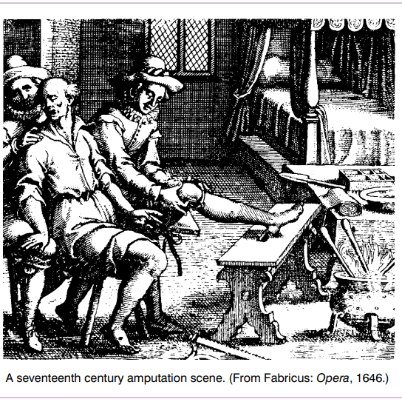

Slide 19
Landmarks of Surgery in the Nineteenth Century
Fundamental advances in surgery were in
fact dependent upon the development of
other branches of science and of
industry which provided, for instance, the
high-powered microscope and the X-ray tube.

Slide 20
Cont’d
It is therefore not surprising that,
after centuries of stagnation, the facilities
that were lacking were all made
available within the span of a
single life-time, at the period
of the Industrial Revolution.

Slide 21
Cont’d
The first epoch-making advance was the introduction of anaesthesia.

Slide 22
The Emergence of Orthopaedics as a Distinct Speciality
Thus at the dawn of the
20th century the stage was set
for the phenomenally rapid evolution of
surgery that has been witnessed by
many still alive today.

Slide 23
Cont’d
With the consequent widening of the
scope of surgical practice orthopaedic surgery, at first encompassed by the general
surgeon, began to branch off as
a distinct science and art; but it was not until after the First World War that it came to be widely recognised as a separate speciality.

Slide 24
The Present
The second half of the 20th
century saw major technological advances in biomaterials, instrumentation and diagnostic techniques.

Slide 25
Cont’d
These have had a major impact
on the practice of orthopaedic surgery, particularly in the development of reliable methods for joint replacement in the
treatment of arthritis.

Slide 26
Cont’d
Another significant advance has been the development of microsurgical techniques, allowing the anastomosis or repair of
very small blood vessels and nerves,
and thus facilitating the transfer of living.

Slide 27
Cont’d
Major advances have been made in
the field of arthroscopy and arthroscopic surgery, allowing patients the benefits of minimally invasive surgery on most of
the major joints in both upper
and lower limbs.

Slide 28
The Future
Limits to the development of improved technology and biomaterials for orthopaedic surgery may now have been reached.
As a result there has been an increasing
interest in methods for restoring normal
tissues, as an alternative to replacing them.

Slide 29
Cont’d
This will require new developments in the field of tissue engineering to allow composites of cultured autogenous or donor stem cells to be combined with a synthetic biodegradable matrix to repair bone and articular cartilage.

Slide 30
References
Reference
Ebnezer, J, (2012): Textbook of Orthopedics Fifth Edition:, Jaypee Brothers Medical Publishers (P) Ltd.
Duckworth, T, and Blundell, C.M, (2013) Orthopaedics and Fractures Fourth Edition:, Wiley-Blackwell publishers.
Sivananthan S., Sherry E, Warnke, P., Miller M.D (2012): Mercer's Textbook of Orthopaedics and Trauma, CRC Press Taylor & Francis Group, Tenth edition
Hamblen. D.L, A Simpson, H.W, (2010) Adams’s Outline of Orthopaedics: Fourteenth Edition, ©Churchill Livingstone Elsevier.

